Slide 1
Novel approaches for visualising time-to-event data
Presenter: Victor Pacifique Rwandarwacu & Shyamsundar Ranganath
Supervisor: Prof. John Newell

Slide 2
PRESENTATION OUTLINE
Background
Definition +rationale
Problem statement
Overview: Survival function, Mean Residual Life (MRL) function
Dataset
Method
Online Survey: clinicians’ knowledge and perspectives on survival data visualization.
Result
Discussion
Strength
Limitations
Conclusion

Slide 3
BACKGROUND
Time-to-event or survival Analysis is the analysis of data in the form of times from a well-defined time origin until the occurrence of an event of interest(Collett, 2023).
Survival data are generally asymmetric and censored, requiring a specific approach to analysis and visualization.
e.g, Survival and Hazard function, KM estimator & plot, etc.
Survival analysis has many applications in clinical practice, ie. time to recurrence, time to discharge.
The survival function is the probability that the survival time is greater than or equal to a time (t), which is the observed value of a random variable (T) with distribution F(t) (Peace, 2009).
Survival ratio and difference are used to estimate relative and absolute difference in survival, respectively (Newell et al., 2006).
Collett, D. (2023). Modelling Survival Data in Medical Research. Taylor & Francis.
Peace, K. E. (2009). Design and Analysis of Clinical Trials with Time-to-Event Endpoints. CRC Press.
Newell, J., Kay, J. W., & Aitchison, T. C. (2006). Survival ratio plots with permutation envelopes in survival data problems.

Slide 4
PROBLEM STATEMENT
Clinicians face challenges including:
understanding standard survival visualizations on probability scales, such as the KM and survival difference plot.
Translation of survival outcome to patients.
The Mean Residual Life (MRL) function is an alternative approach for communicating survival outcomes to patients.
The MRL function provides a clear and simple summary of the effect of a treatment or a risk factor in units of time, avoiding probability scales, which require careful interpretation. (Alvarez-Iglesias et al., 2015).
There was no prior study about the preference of clinicians between Survival and MRL function.
Alvarez-Iglesias, A., Newell, J., Scarrott, C., & Hinde, J. (2015). Summarising censored survival data using the mean residual life function. Statistics in Medicine, 34(11), 1965–1976.

Slide 5
OBJECTIVE + DATASET
Explore time-to-event visualization: survival versus MRL function
Kaplan-Meier Plot
Survival difference Plot
Mean Residual Life (MRL)plot
Mean Residual Life (MRL) difference plot
Assess knowledge and preference of medical doctors and students on time to event data visualization →online survey
Dataset
Open Access
NIH National Cancer Institute, TCGA Program on a project called “Breast invasive carcinoma (BRCA)”.

Slide 6
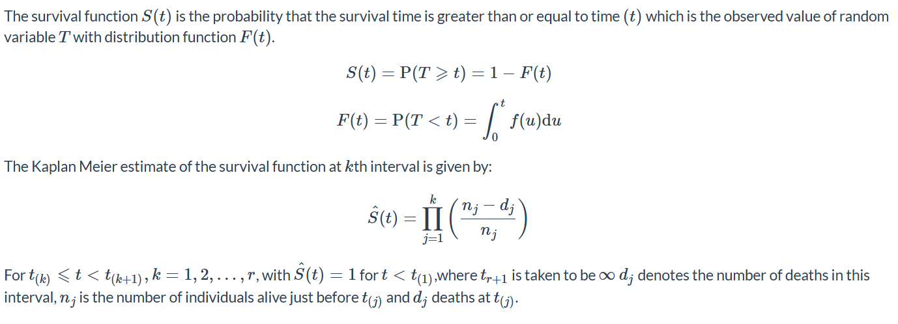
SURVIVAL FUNCTION
Notes:
Explain step function nature of KM
Greenwood’s formula.
Greenwood’s formula. (to be added )
Survival difference → standard error estimation

Slide 7
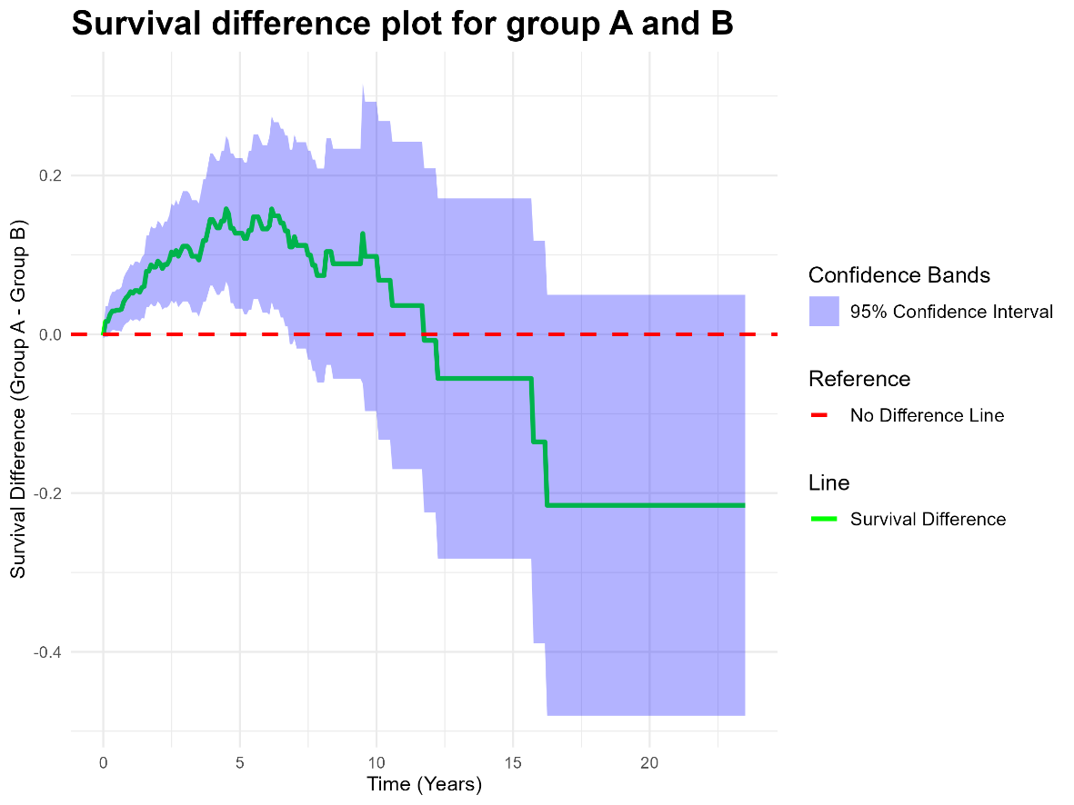
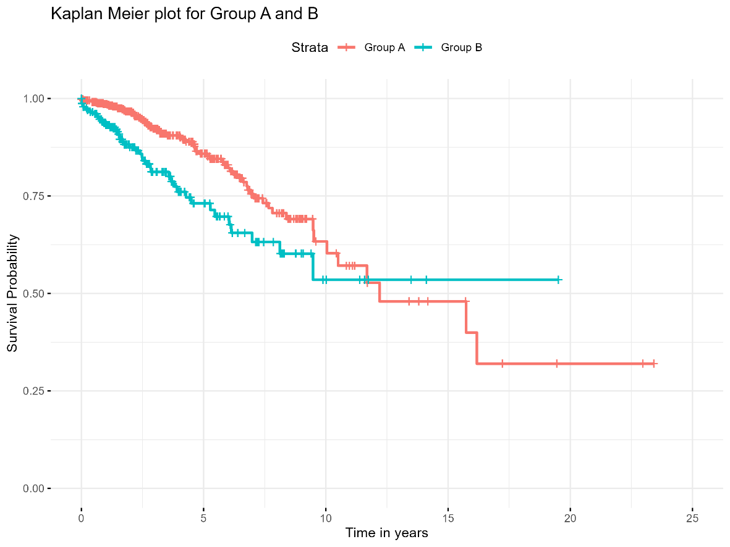
KM AND SURVIVAL DIFFERENCE PLOTS

Slide 8
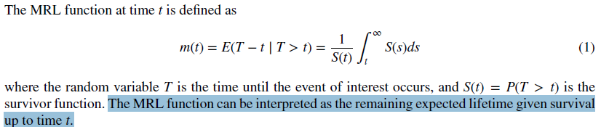
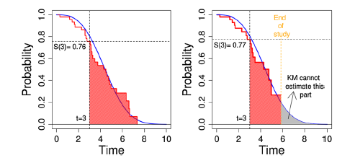
Mean Residual Life (MRL) Function
Alvarez-Iglesias, A., Newell, J., Scarrott, C., & Hinde, J. (2015). Summarising censored survival data using the mean residual life function. Statistics in Medicine, 34(11), 1965–1976.
Notes:
GPD
Extreme value Theory

Slide 9
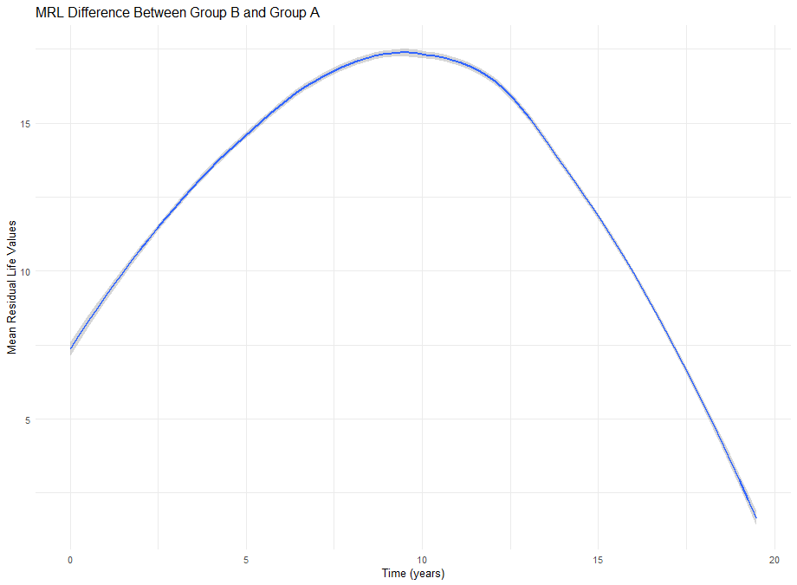
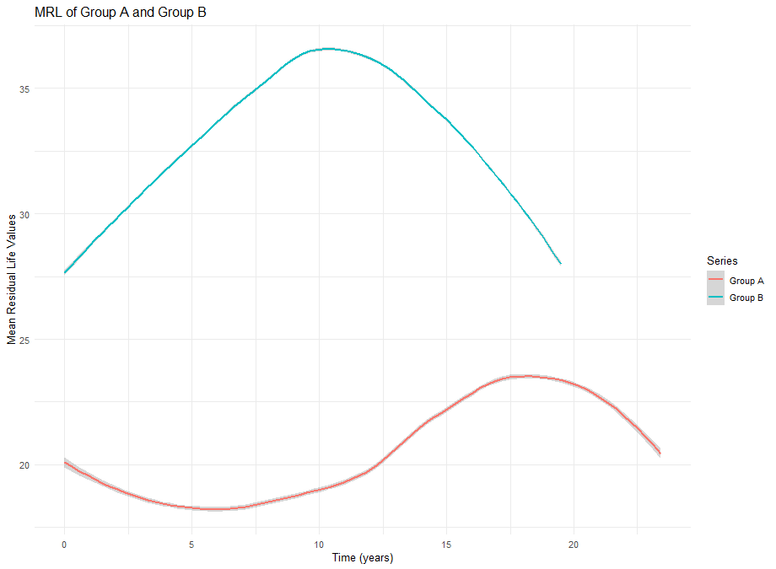
MRL & Difference in MRL plot

Slide 10
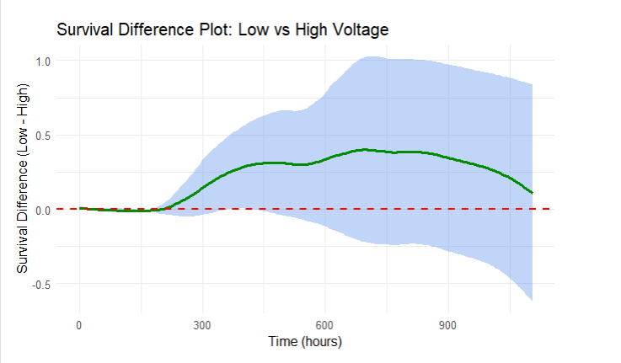
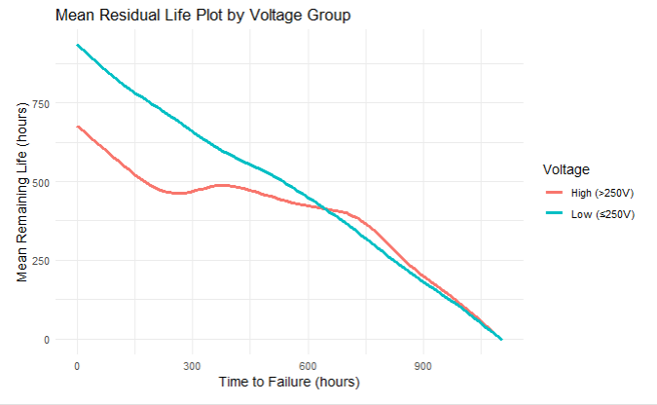

Slide 11
Survey: clinicians’ perspectives on survival data visualization

Slide 12
SURVEY DESCRIPTION
Target population: Medical Students & Doctors
Data collection: anonymous online survey (Google form)
Convenience sampling (Voluntary, no randomization)
No ethical approval required
Data collection Period: 15th April - 20th May 2025 (5 weeks)
Outcome :
Proportion of correct interpretation before and after the provision of the correct interpretations
preferences across KM, survival difference, MRL, and MRL difference plot for clinicians’ understanding and patients’ communication.

Slide 13
QUESTIONNAIRE STRUCTURE
Demographic information (Country and Qualification)
Self-rated knowledge on survival analysis (1 to 10 scale)
Four plots for interpretation (Pre-assessment)
Provision of correct interpretations for the pre-assessment (learning section)
New plots for interpretation(Post- assessment)
Ranking 1: plot easy to understand by clinician (easy to hard)
Ranking 2: plot that clinician prefer to use in consultation with the patient(easy to hard)

Slide 14
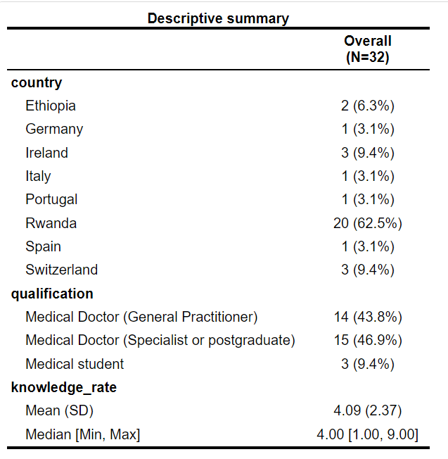
Demography & Result 1
In total, 32 responses were analyzed
75% of respondent's self-rated =< 5 /10 on survival knowledge.
Data analysis (NVivo and R)

Slide 15
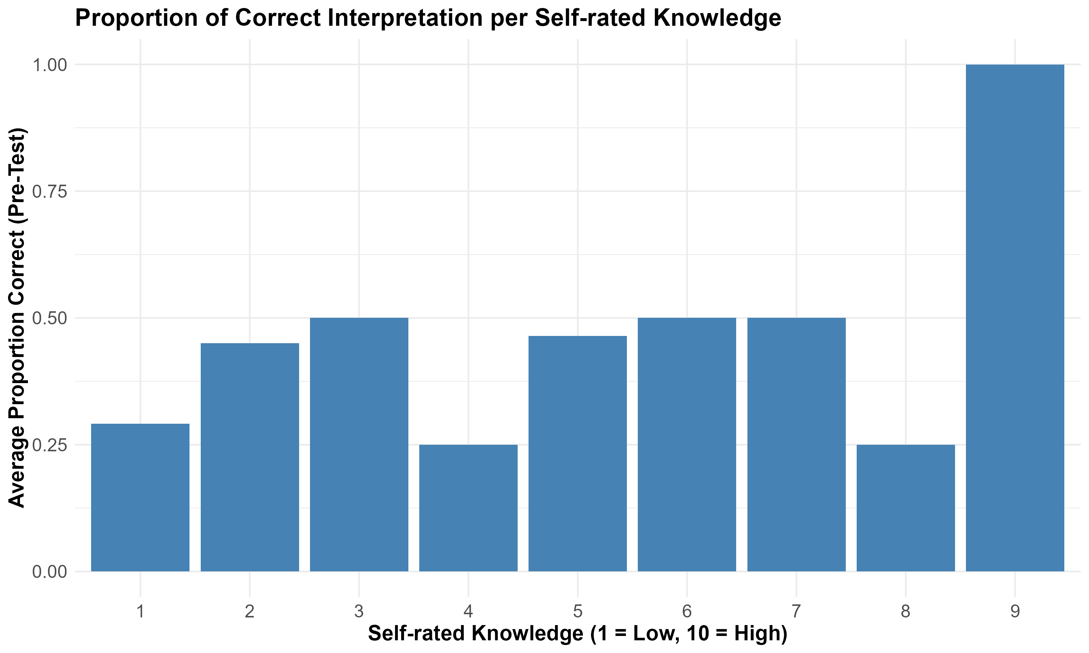
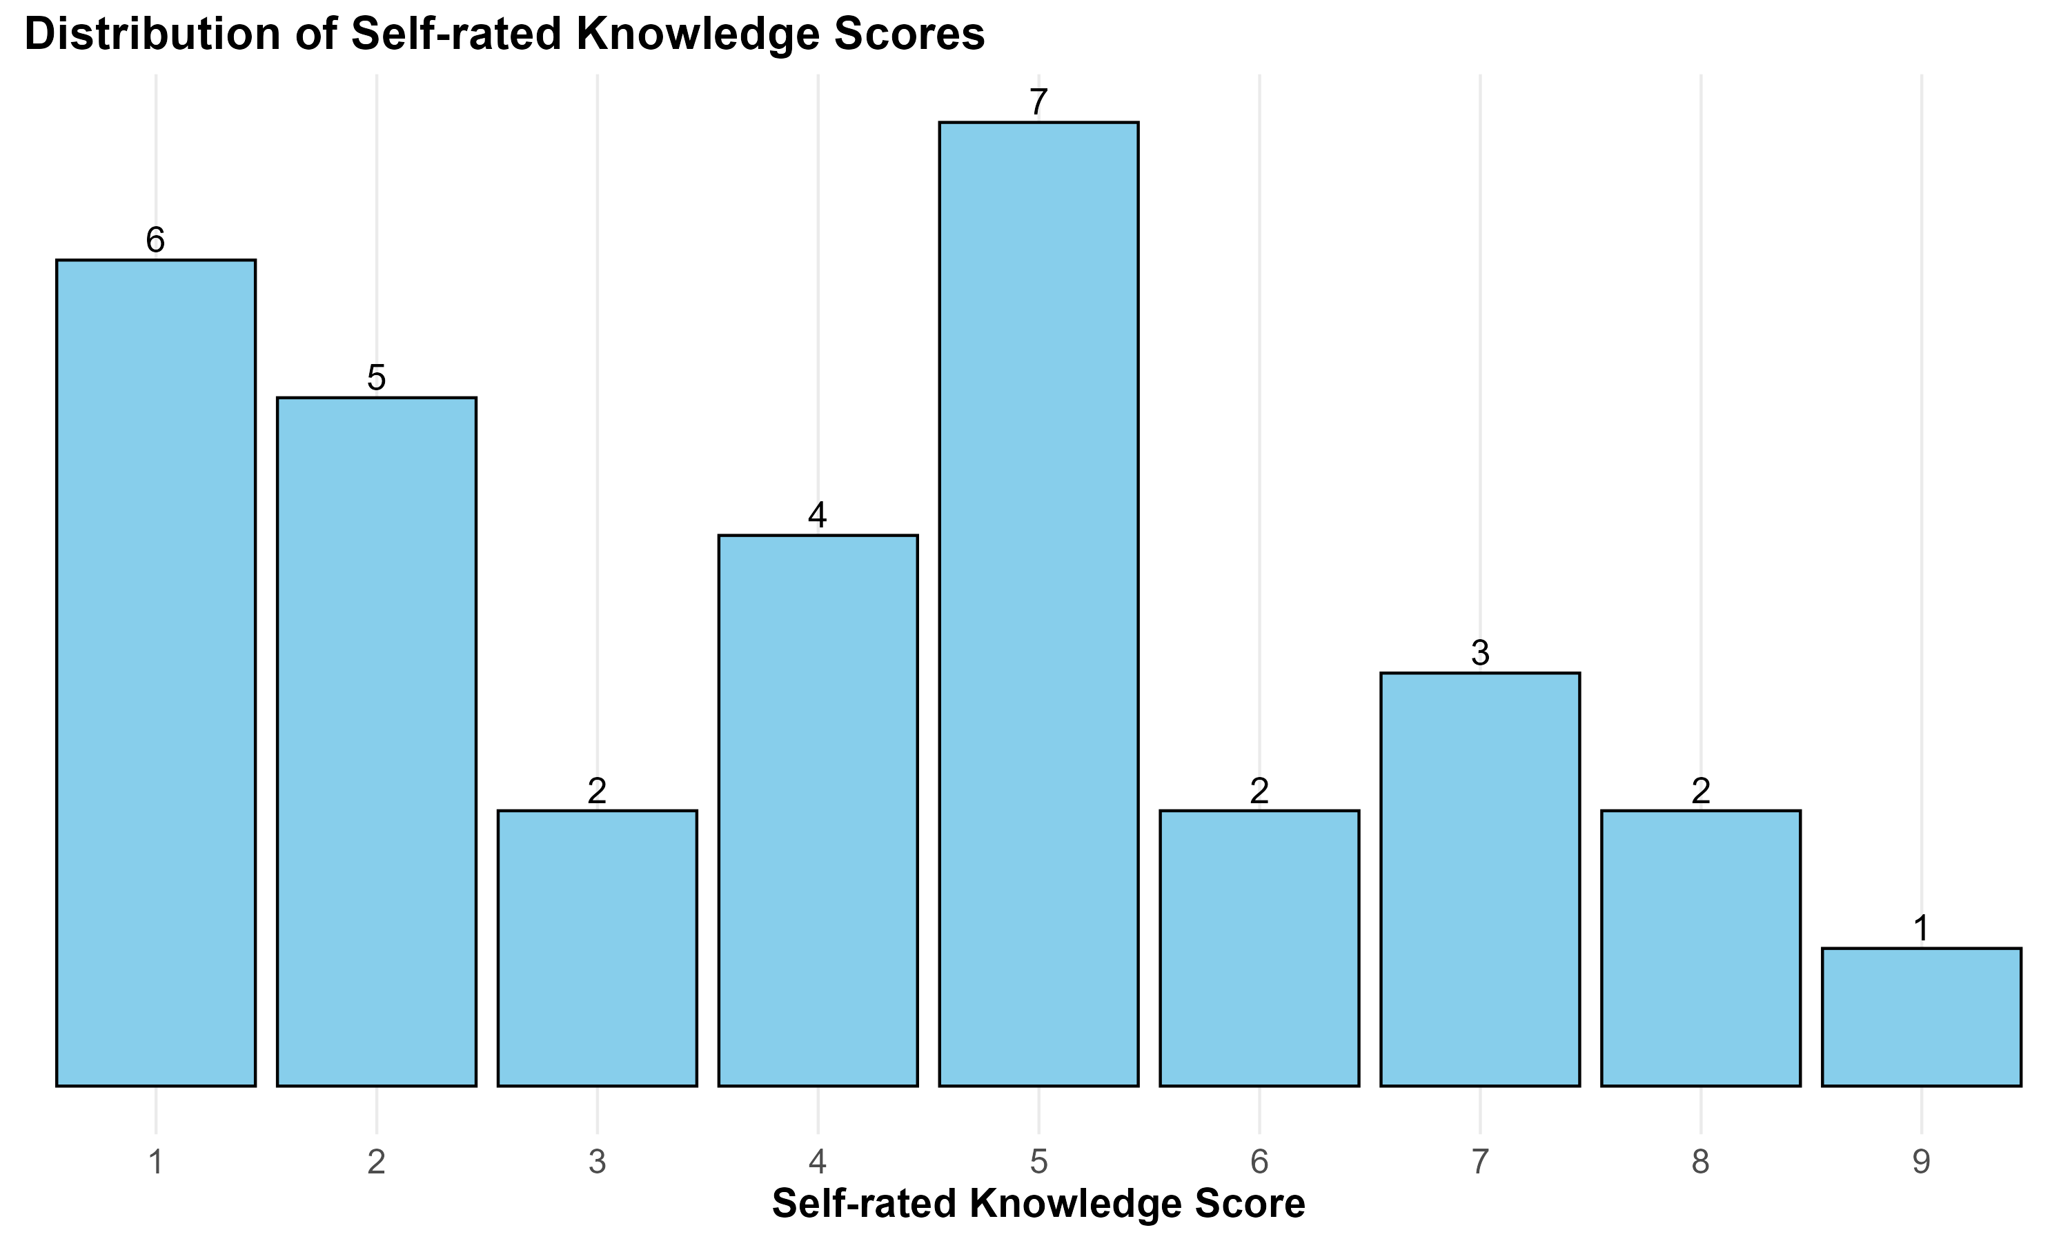
Notes:
Rates 5 and 1 were the most prevalent, with frequencies of 7 and 6 respectively
Do those who say they know actually know?

Slide 16
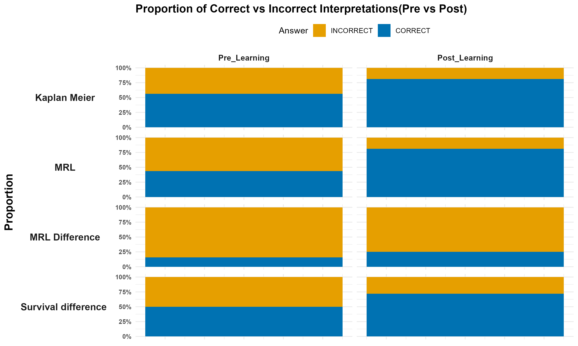
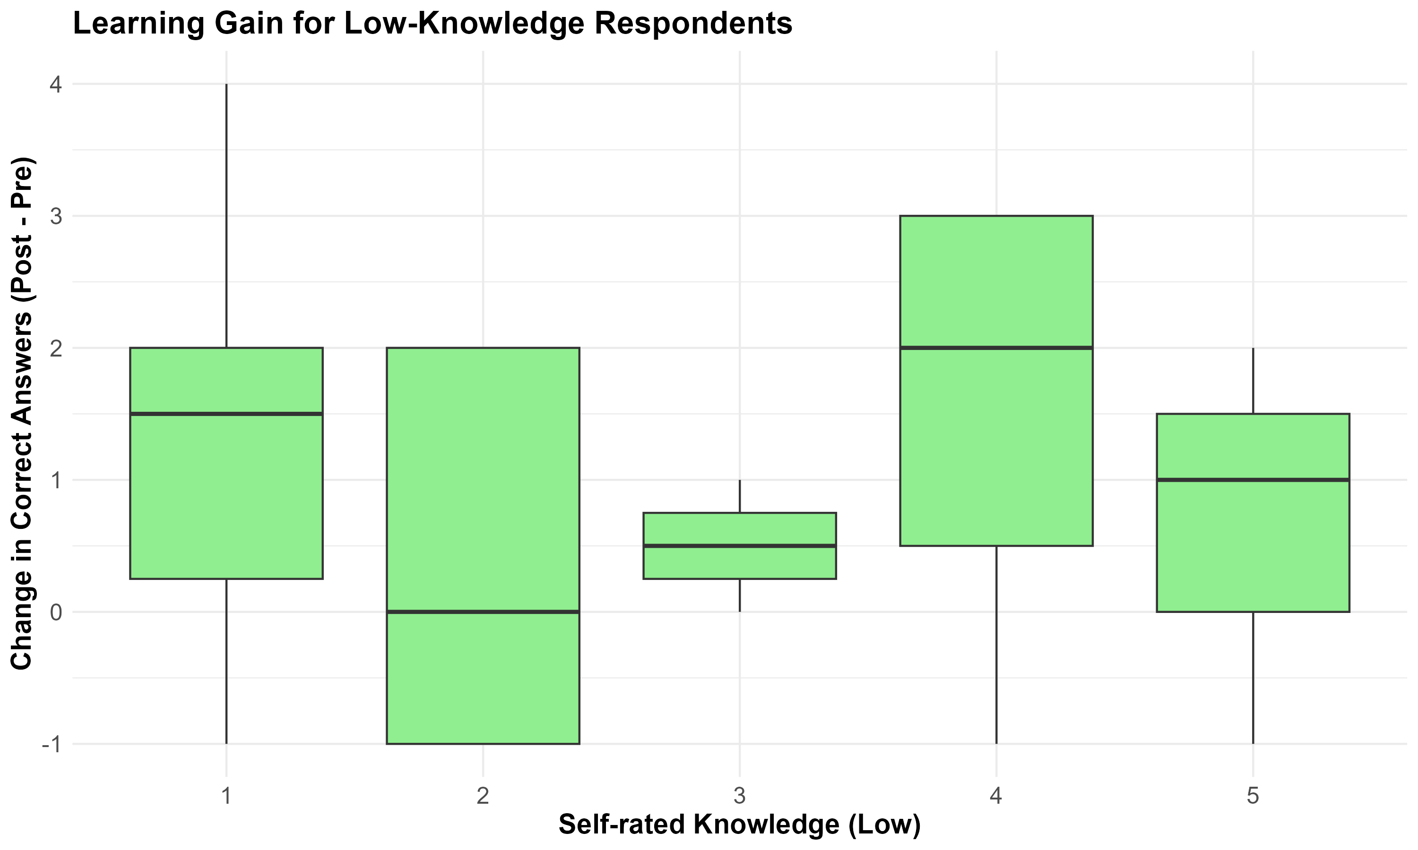
Knowledge Gain
p value= 0.027
p value=0.0095
p value=0.547
p value= 0.096
Notes:
There was more improvement on the Mean residual Life plot (Pre versus post)-→ New knowledge and easy to grasp
Overall learning effect was positive for those with lower self-rated knowledge.
McNemar Test

Slide 17
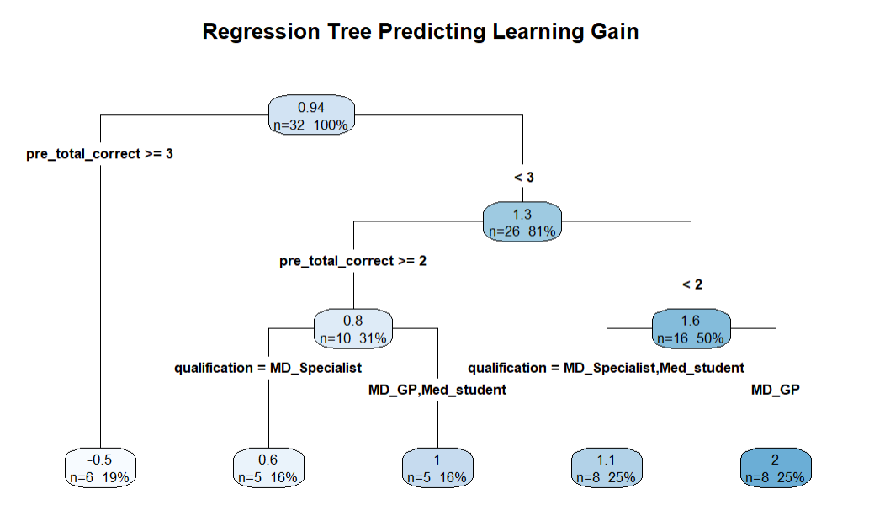
Knowledge Gain - Regression Tree
Notes:
There was no knowledge gain for clinicians who scored above 50% on the pretest on average

Slide 18
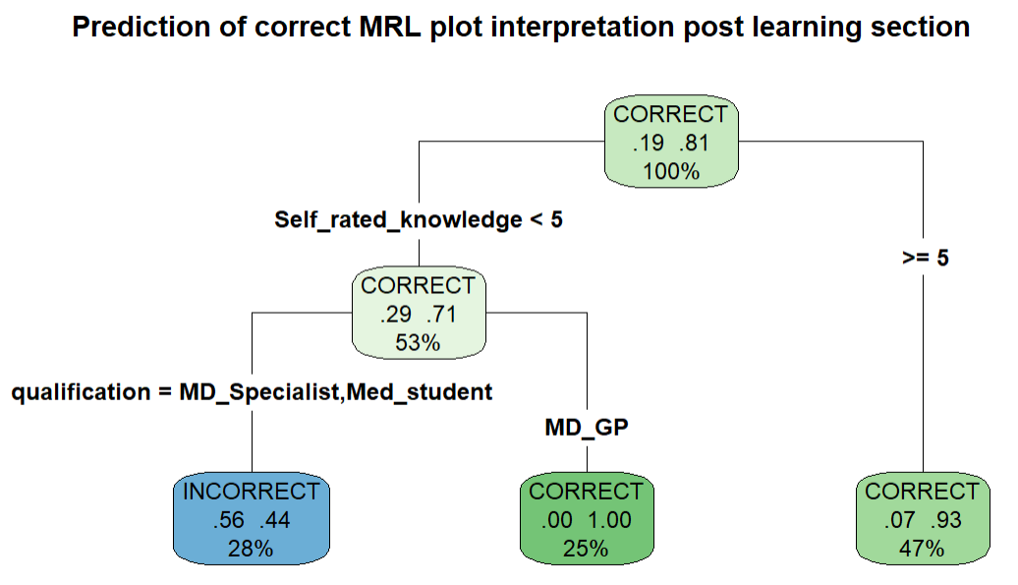
Notes:
There was a noticeable increase in the accuracy of interpretation for MRL.
The correct interpretations were more from general practitioner from Ethiopia,Ireland,Portugal,spain and Switzerland.

Slide 19
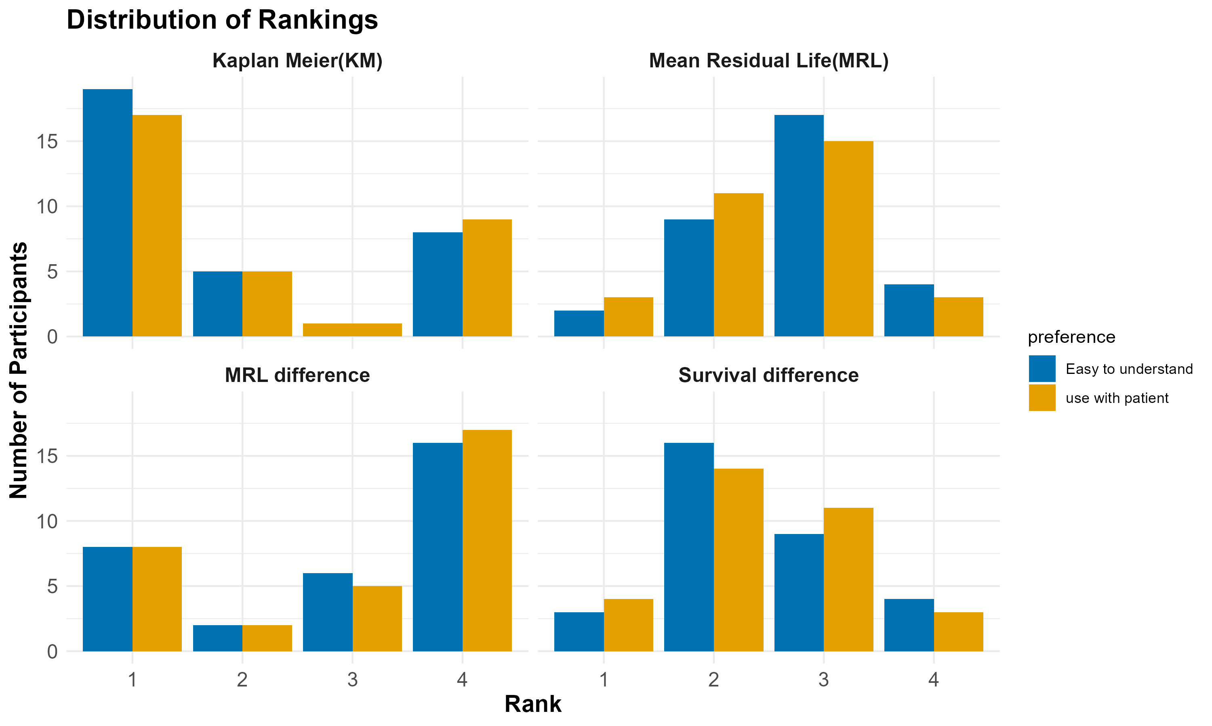
Ranking distribution
Notes:
Kaplan-Meier is the most preferred plot, followed by: Survival difference, MRL plot, and MRL difference plot, respectively.

Slide 20
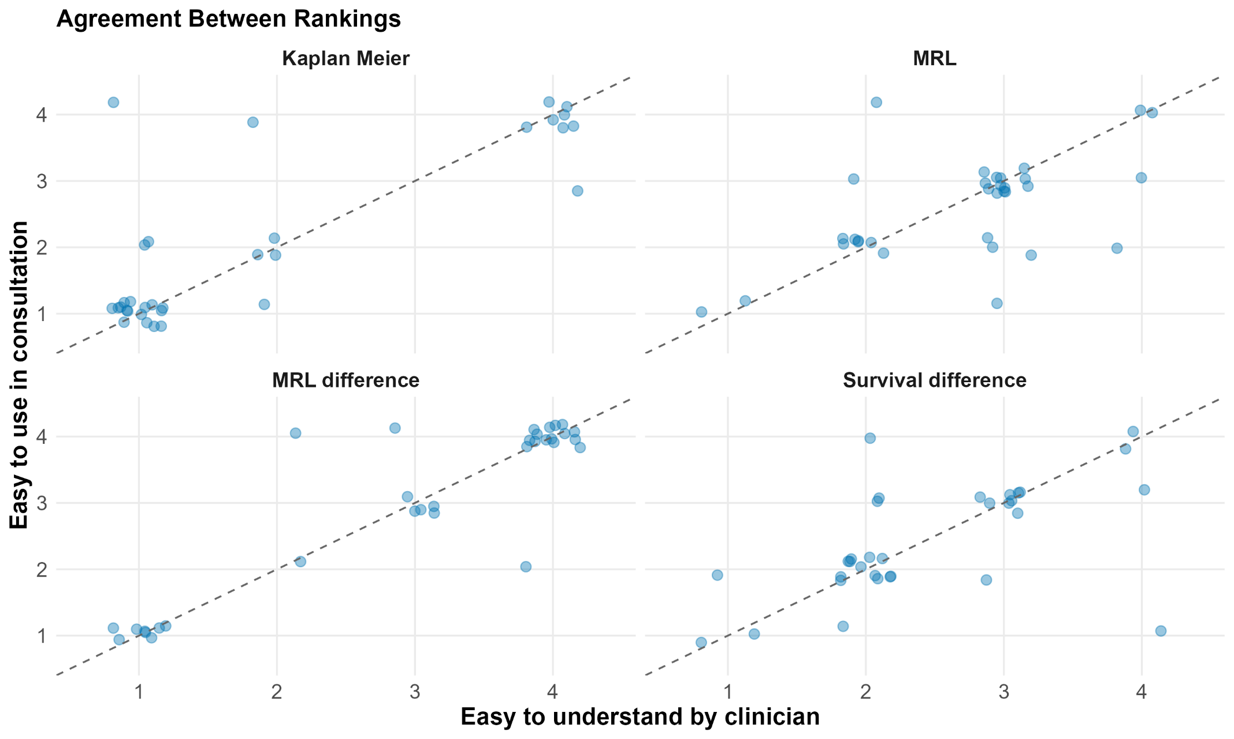
Ranking changes

Slide 21
STRENGTH & LIMITATIONS OF THE STUDY
Strength
Novel
Mixed-methods Approach
Primary data collection
Limitation
Convenience sampling → Risk of bias, and limited generalizability
uncontrolled survey environment setting
Short data collection period and limited sample size

Slide 22
CONCLUSION
There is limited knowledge in survival plot interpretation among medical doctors and students.
The respondents are more familiar with the Kaplan-Meier graph compared to the other presented graphs. However, they were learning still learning an effect.
MRL function is a new concept for clinicians.
MRL plot has the highest and significant improvement in accuracy of interpretations -→ thus, it’s easy to learn and apply.
WAY FORWARD:
The survey is still ongoing to collect more insights from clinicians (pilot).
Conduct a main study in a controlled setting.

Slide 23
REFERENCES
Alvarez-Iglesias, A., Newell, J., Scarrott, C., & Hinde, J. (2015). Summarising censored survival data using the mean residual life function. Statistics in Medicine, 34(11), 1965–1976.
https://doi.org/10.1002/sim.6431
Collett, D. (2023). Modelling Survival Data in Medical Research. Taylor & Francis. https://books.google.ie/books?id=rIp0zwEACAAJ
Peace, K. E. (2009). Design and Analysis of Clinical Trials with Time-to-Event Endpoints. CRC Press. https://books.google.ie/books?id=3f_LBQAAQBAJ
Portal.gdc.cancer.gov/projects/TCGA-BRCA. (n.d.). Retrieved May 26, 2025,
https://portal.gdc.cancer.gov/projects/TCGA-BRCA
Newell, J., Kay, J. W., & Aitchison, T. C. (2006). Survival ratio plots with permutation envelopes in survival data problems. Computers in Biology and Medicine, 36(5), 526–541.
https://doi.org/10.1016/j.compbiomed.2005.03.005

Slide 24
THANK YOU!

Slide 25
ANNEX
To be used per need or during Q&A

Slide 26
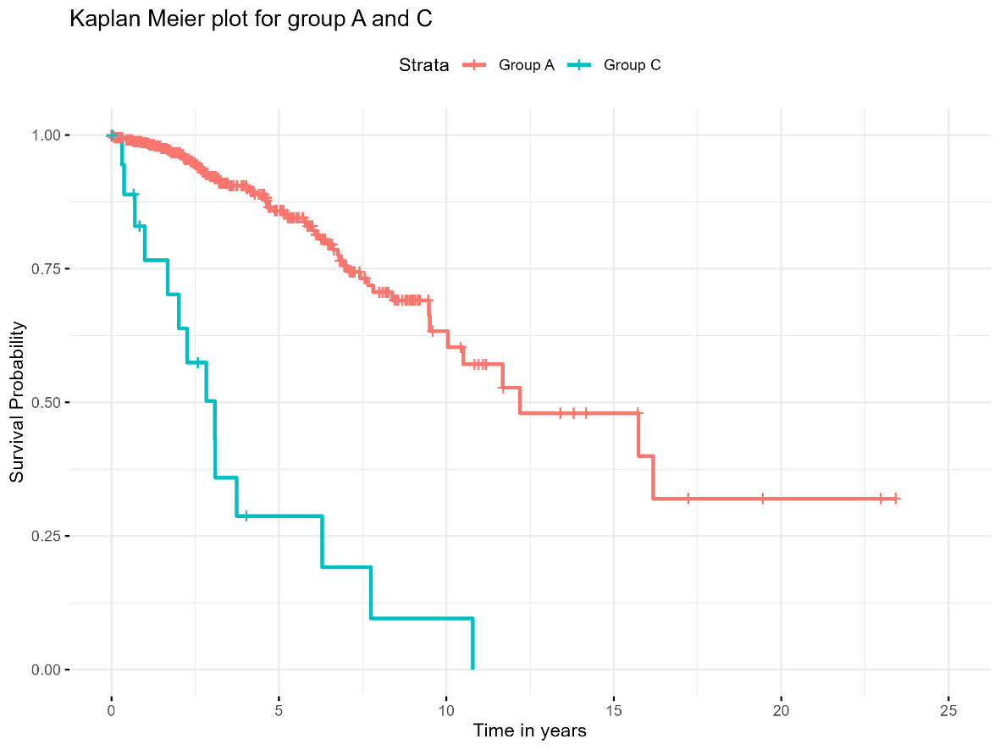
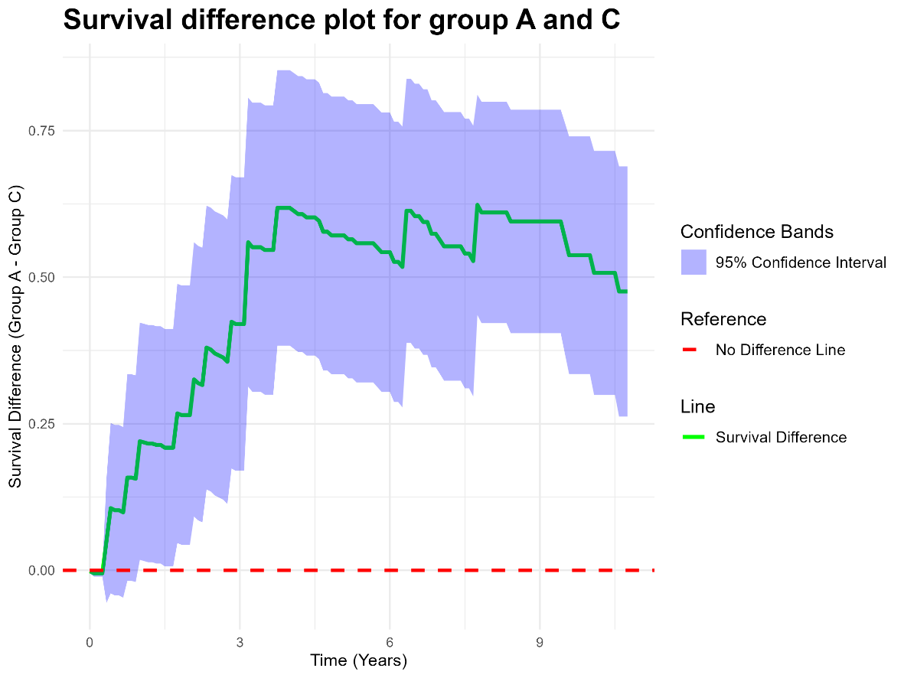
POST: Survival function plots

Slide 27
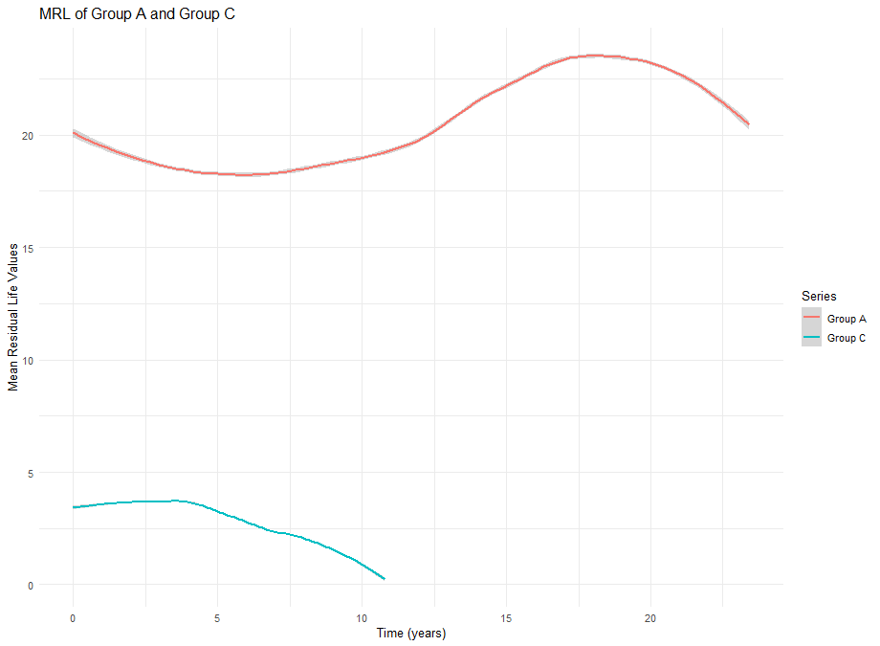
POST= MRL PLOTS

Slide 28
